Slide 1
7047 E. Greenway Pkwy, Suite 160 Scottsdale, AZ 85254
Phone: (480) 525-8138

Slide 2
Yiwu (China)
Dragon Mart (Dubai)
PhoenixMart (USA)

Slide 3
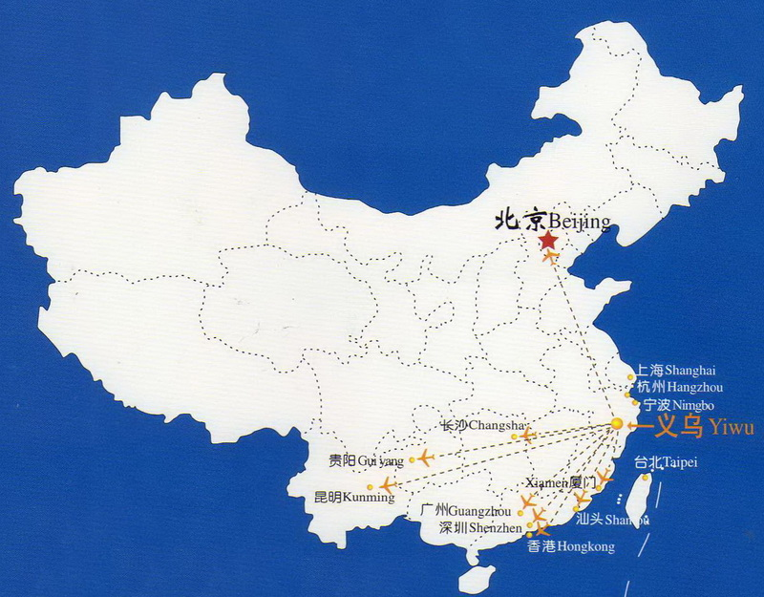
Yiwu: From A Small Rural Town to The World Marketplace
The largest commodities center in the world
In 2011, 590,000 visiting foreign merchants; More than 3,000 representative offices of foreign enterprises. GDP $13 billion
11 Specialized Markets; 14 merchandise streets; 43 million square feet of commercial space; 80,000 shops; 1.7 million products; and 18,000 brands
2 minutes per shop, 8 hours per day, 1 YEAR for all shops.

Slide 4
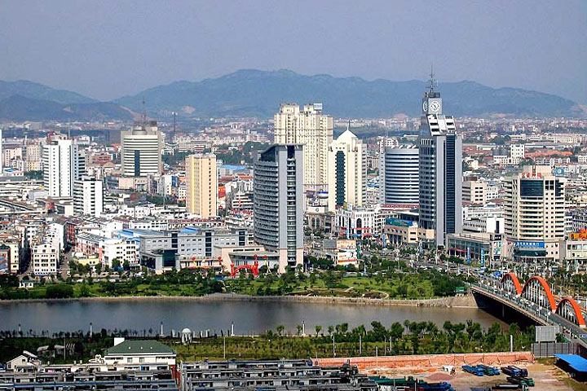
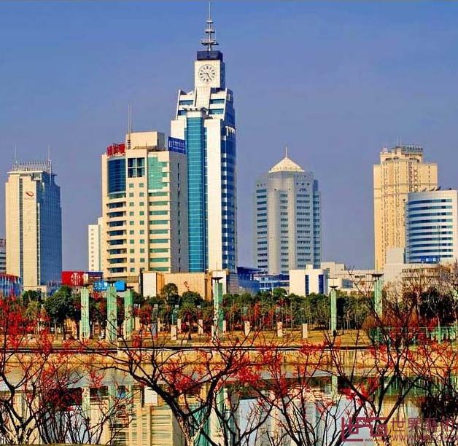
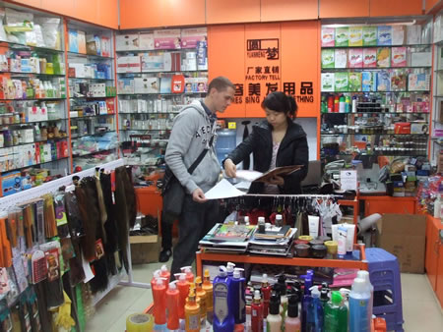
Yiwu: Today

Slide 5
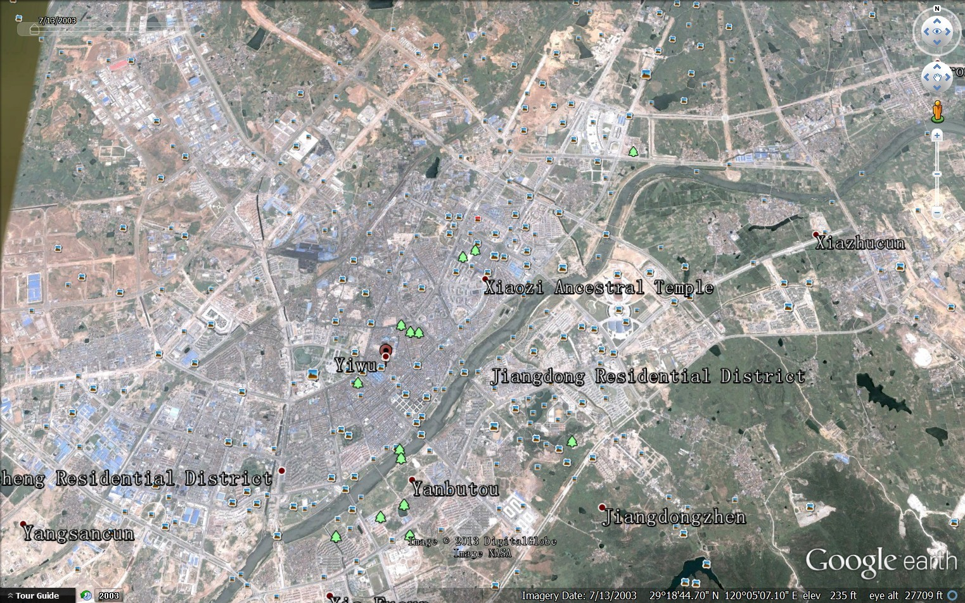
Yiwu commodity market started in 1986.
Yiwu: 2003
13.1 million square feet of commercial space

Slide 6
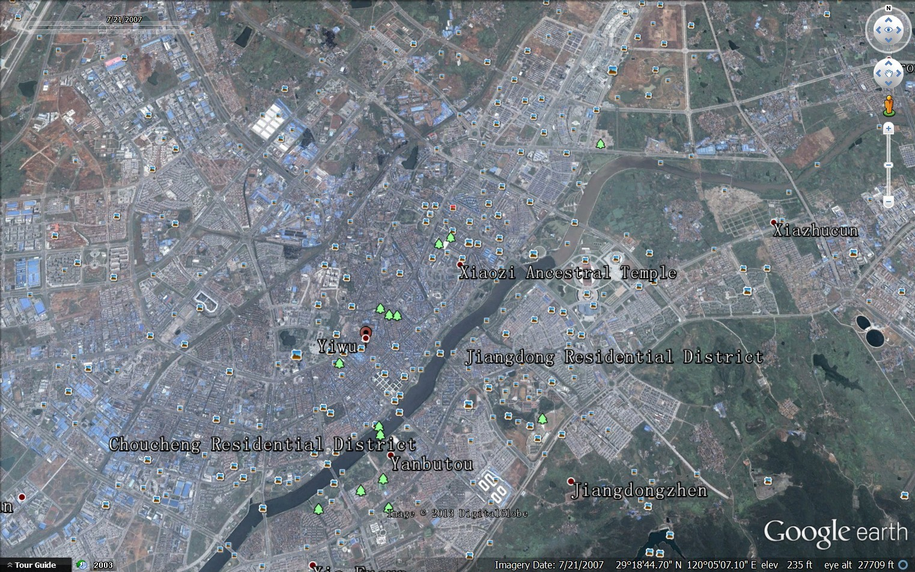
Yiwu: 2007
24.5 million square feet of commercial space

Slide 7
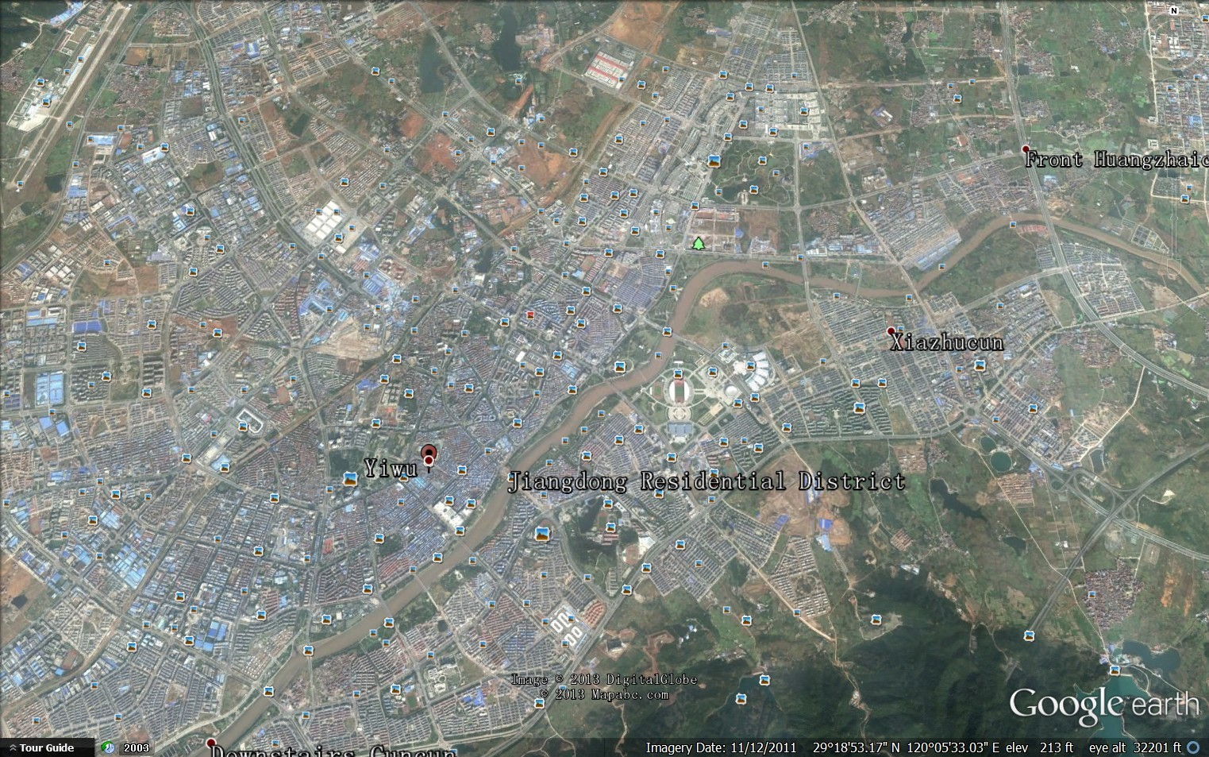
Yiwu: 2011
43 million square feet of commercial space

Slide 8
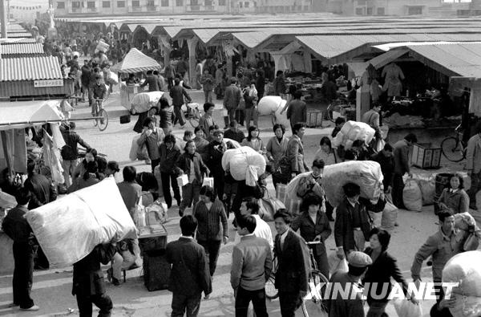
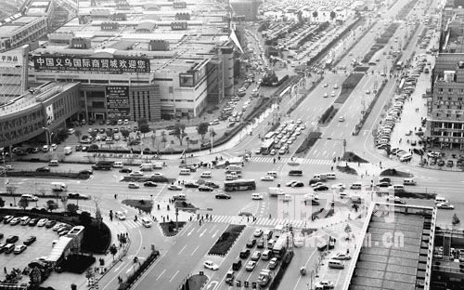
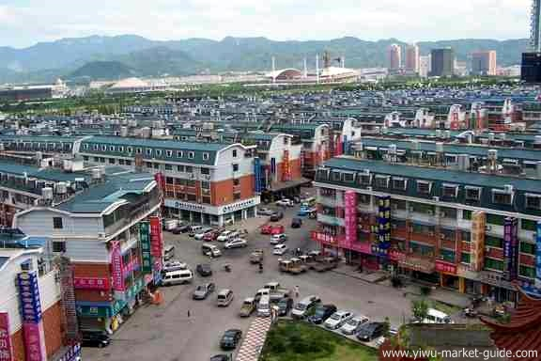
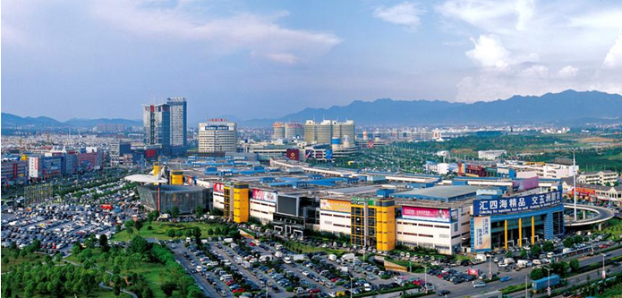
Yiwu: Development
Yiwu: 1986
Yiwu: 2002
Yiwu: 2006
Yiwu: 2012

Slide 9
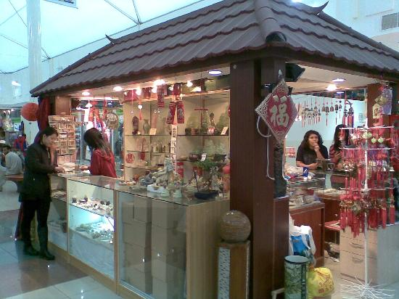
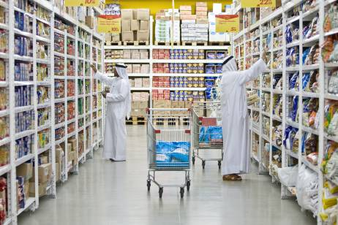
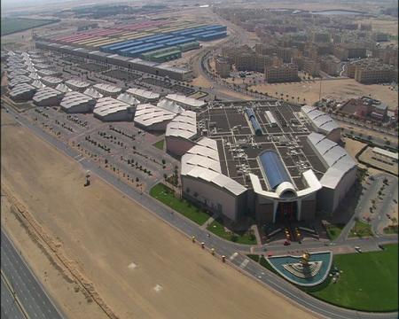
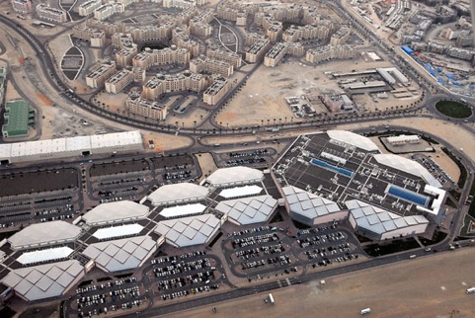
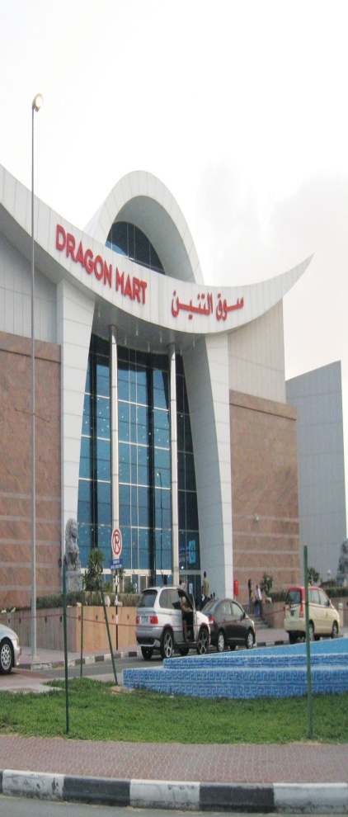
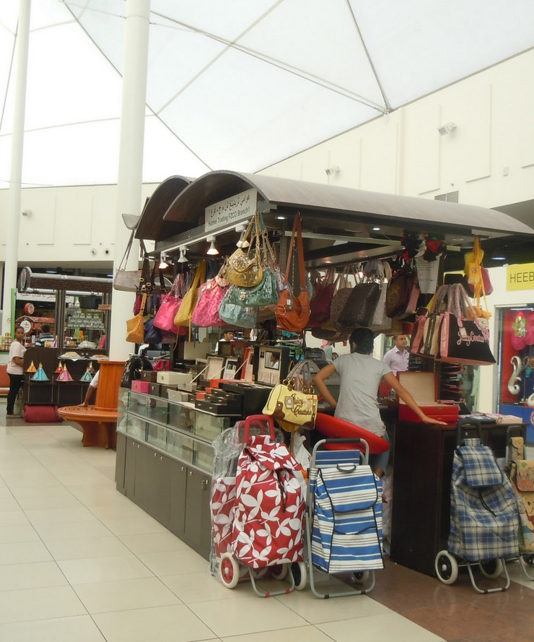
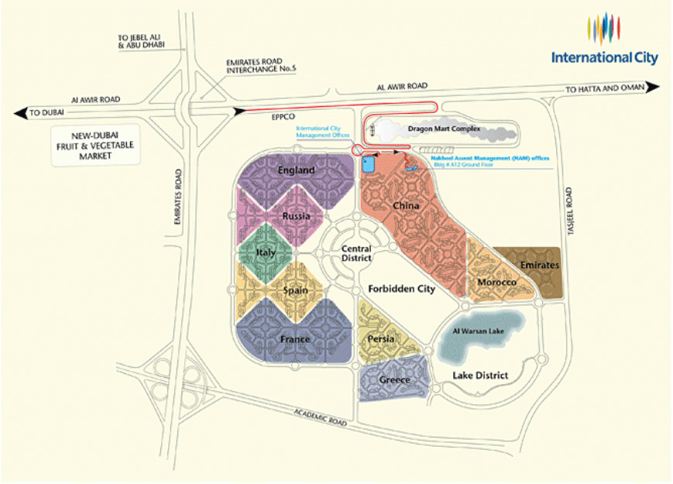
Dragon Mart: The Dubai Trading Center + Commercial Master Planned Development

Slide 10
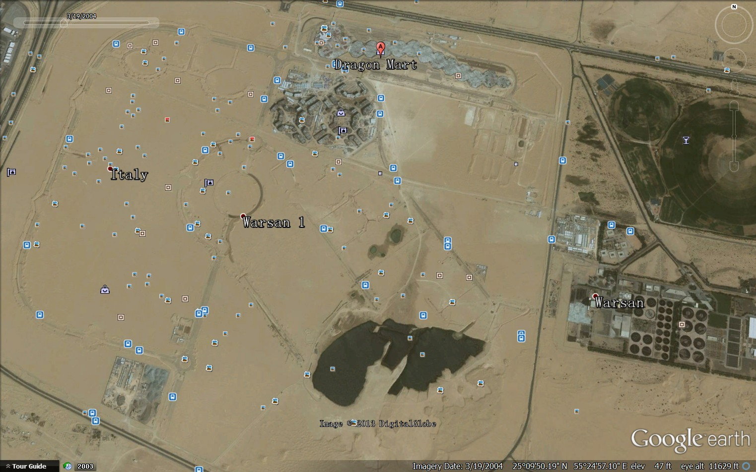
Dragon Mart: 2004, commenced construction

Slide 11
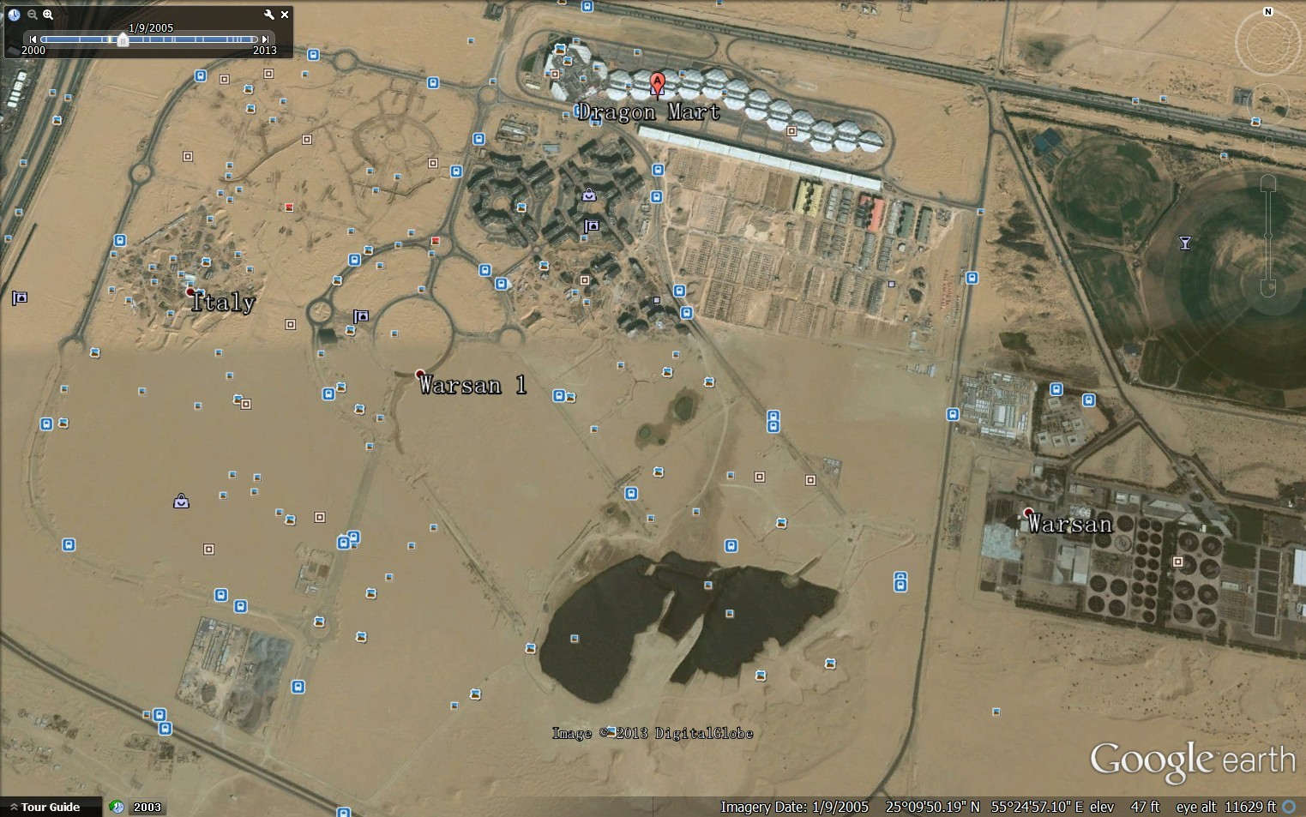
Dragon Mart: 2005, Operating
1.6 million square feet of commercial space, adjacent to 320,000 square feet of equipped warehouses.

Slide 12
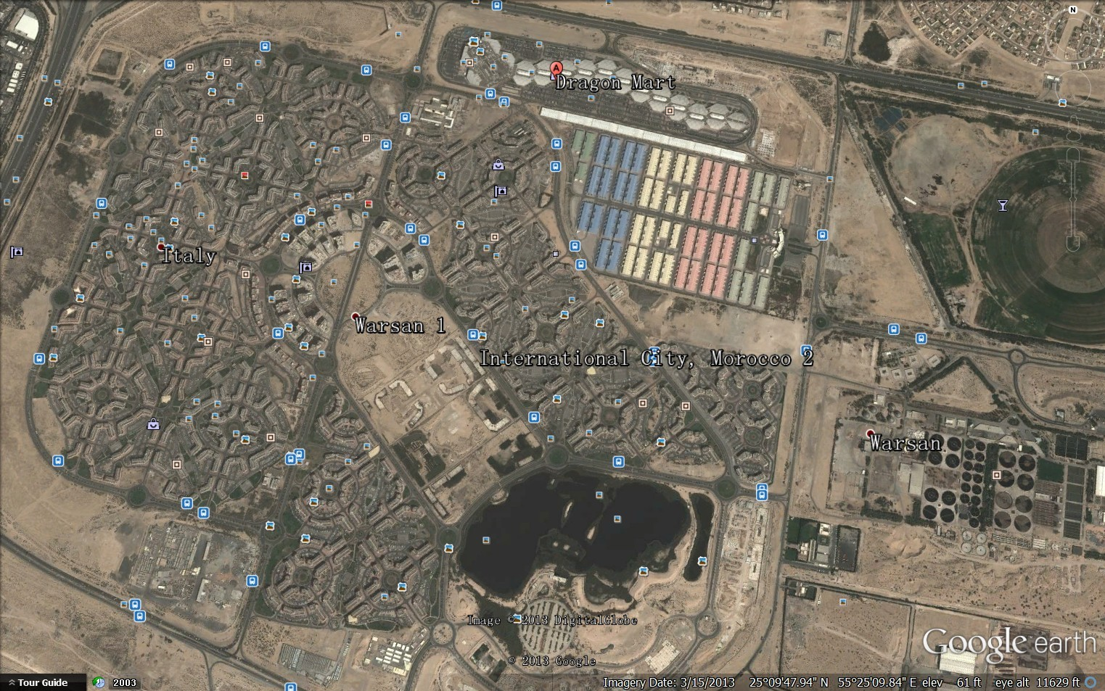
Dragon Mart: 2013
1,977 acres,13 districts, 485 buildings: including residence, commercial shops, restaurants, medical centers, police station, and transportation services.

Slide 13
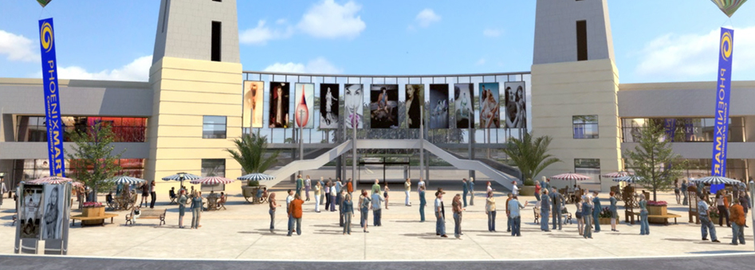
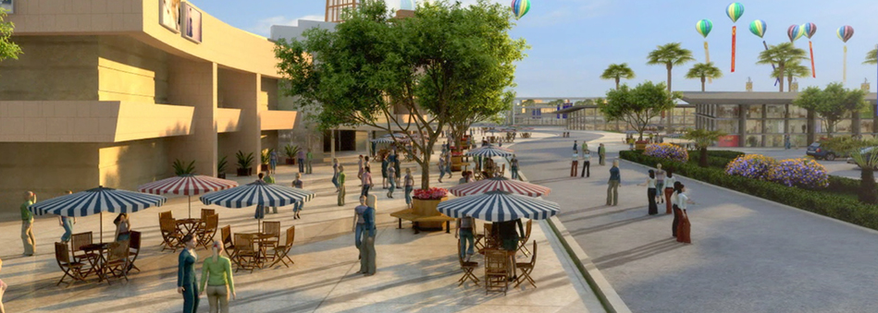
PhoenixMart: Tomorrow
http://www.phoenixmart.com/

Slide 14
PhoenixMart: a one-stop shop with six distinct product centers

Slide 15
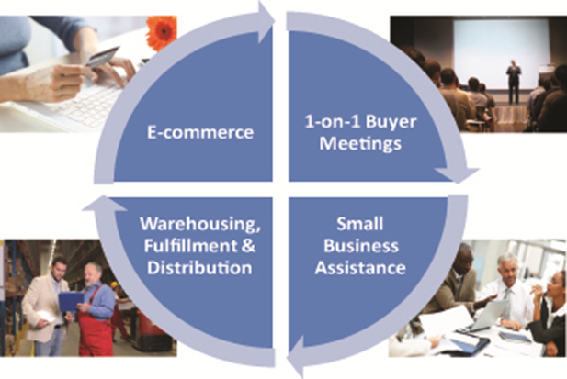
: facilitate transactions between tenants and buyers and it does this through its innovative Affinity Program
Legal Services
Logistics and Warehousing
Human Resources and Operations
Trade Events
Marketing Services

Slide 16
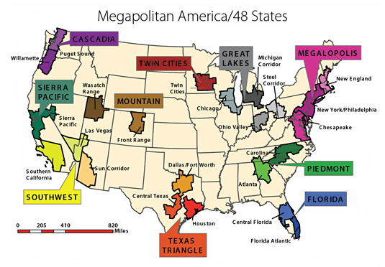
PhoenixMart: Location, Location, Location

Slide 17
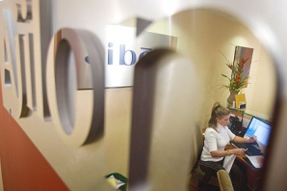
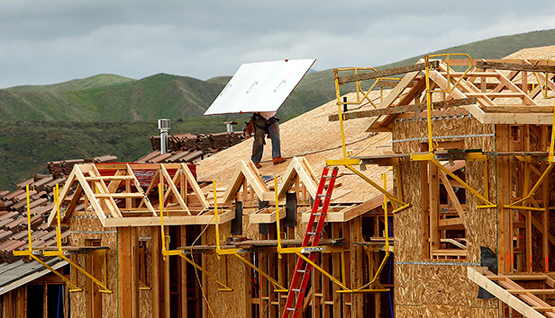
Why Arizona + Sun Corridor?
Top 10 Economic Growth in 2012
Job Creation: 49,000 in 2012; 60,000 in 2013
Among the highest for population growth from other states
Real estate market in high demand
More efficient business operations

Slide 18
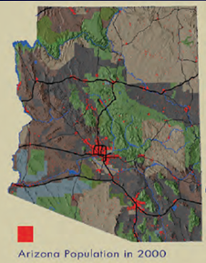
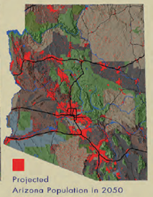
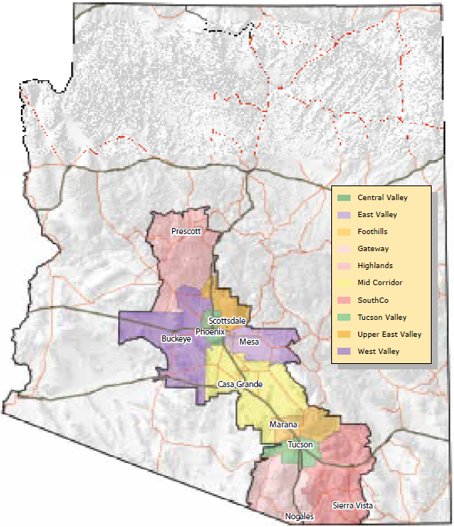
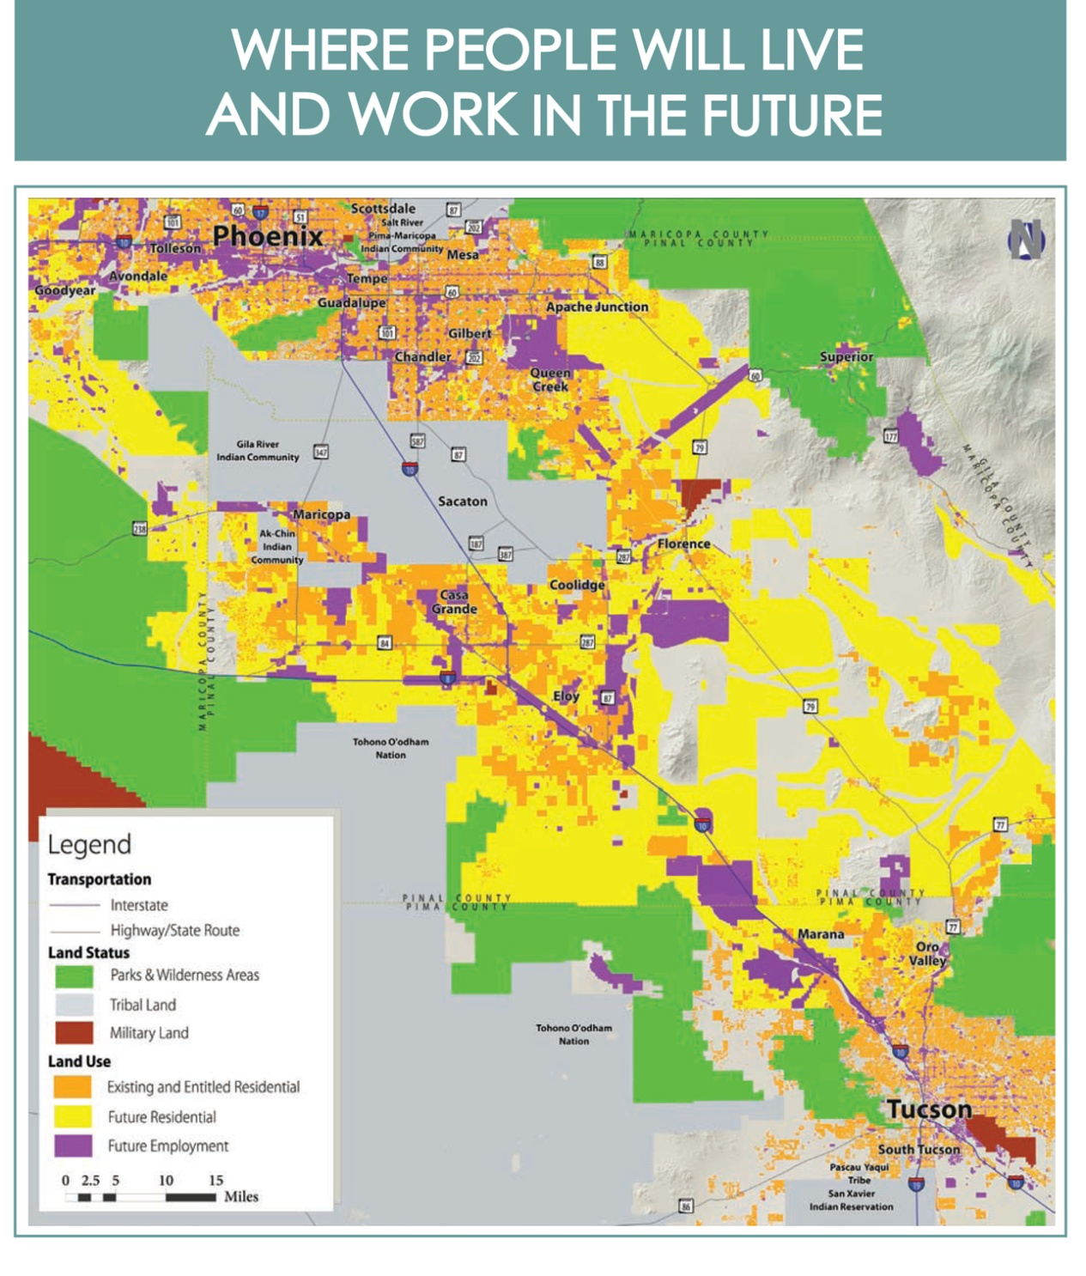
PhoenixMart: at the heart of Sun Corridor
PhoenixMart
PhoenixMart
PhoenixMart

Slide 19
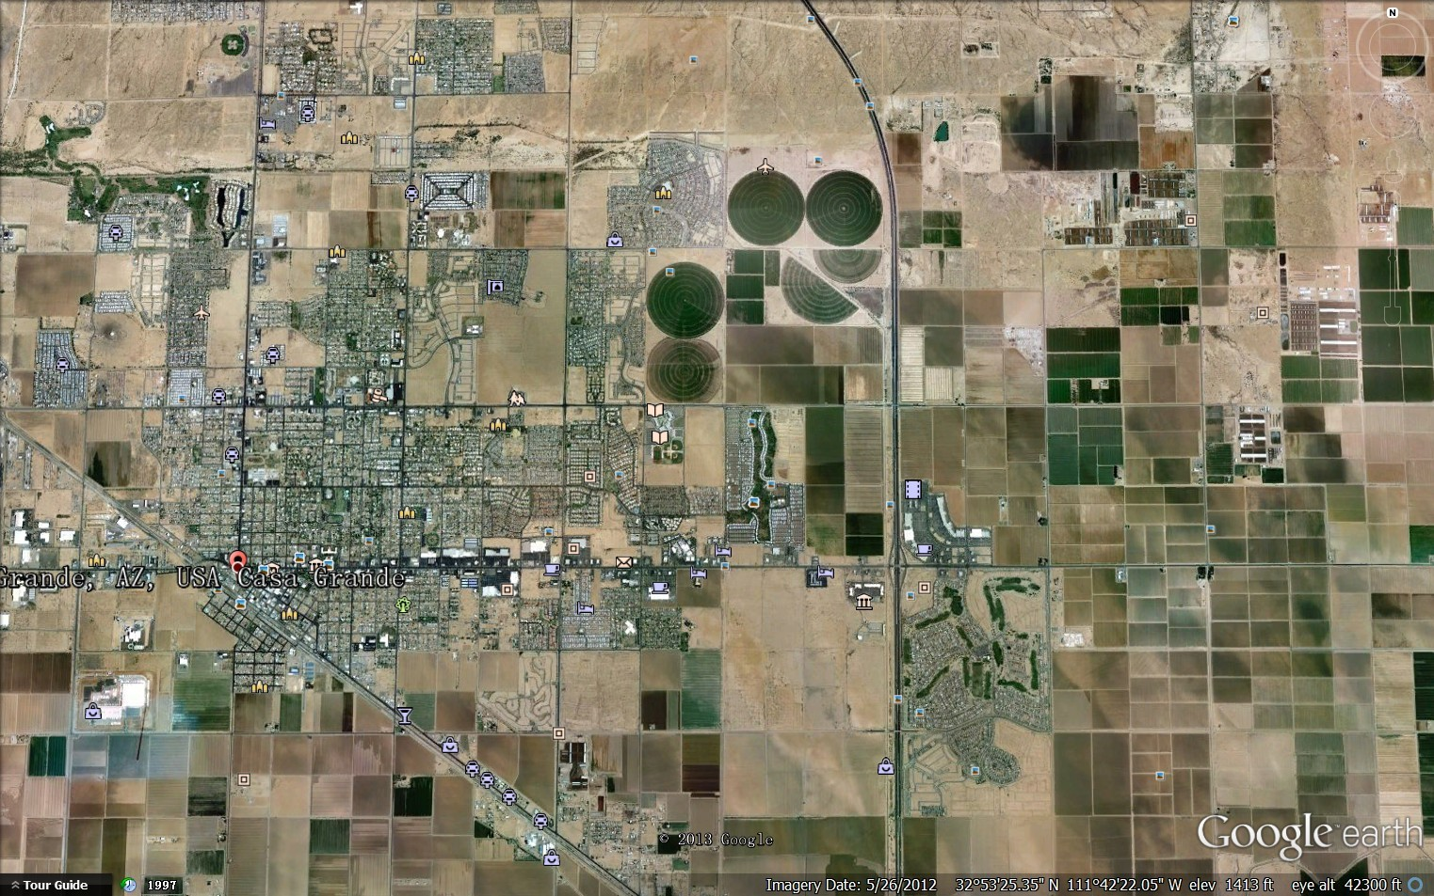
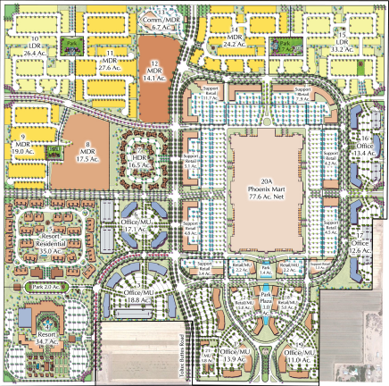
Casa Grande: 2012

Slide 20
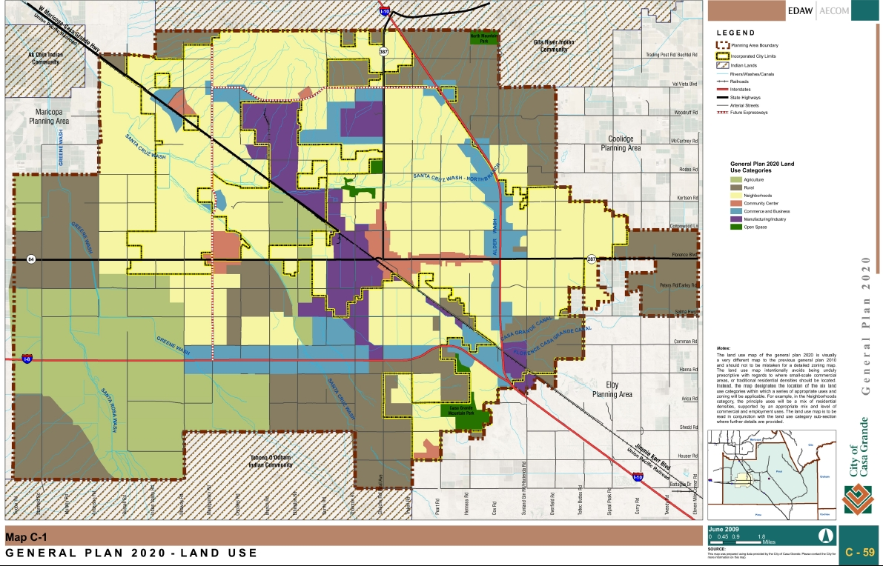
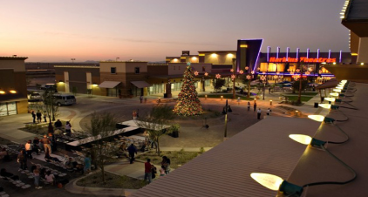
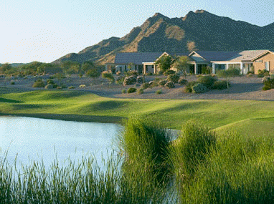
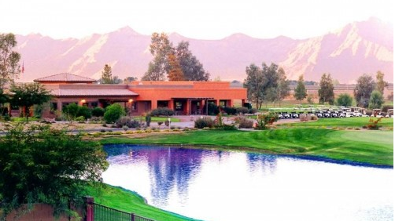
Casa Grande: Development Plan
Shopping Mall
PhoenixMart
Golf Club

Slide 21
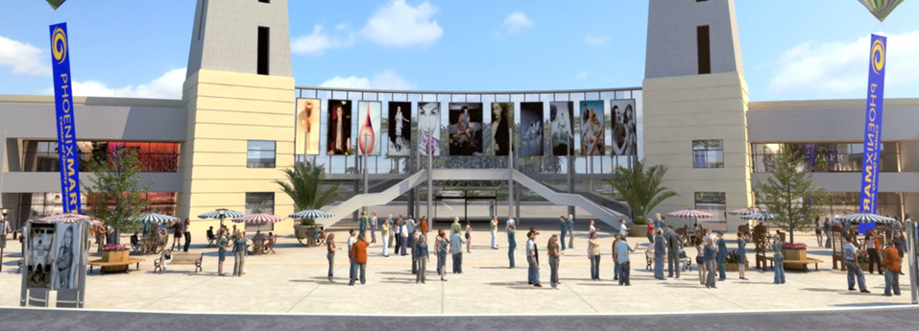
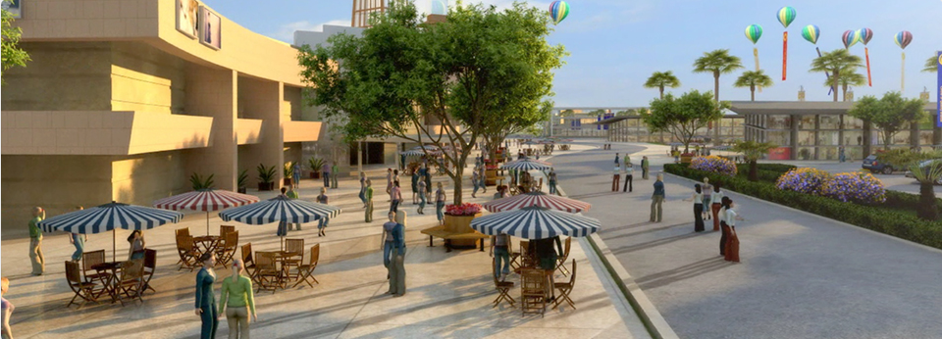
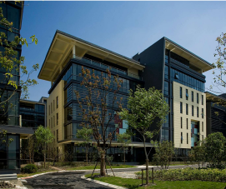
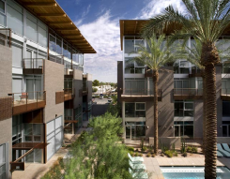
PhoenixMart: Development Plan & Building Design
585 acres of master-planned community;1.7 million square feet of multi-functional wholesale, retail, entertainment and convention center space.

Slide 22
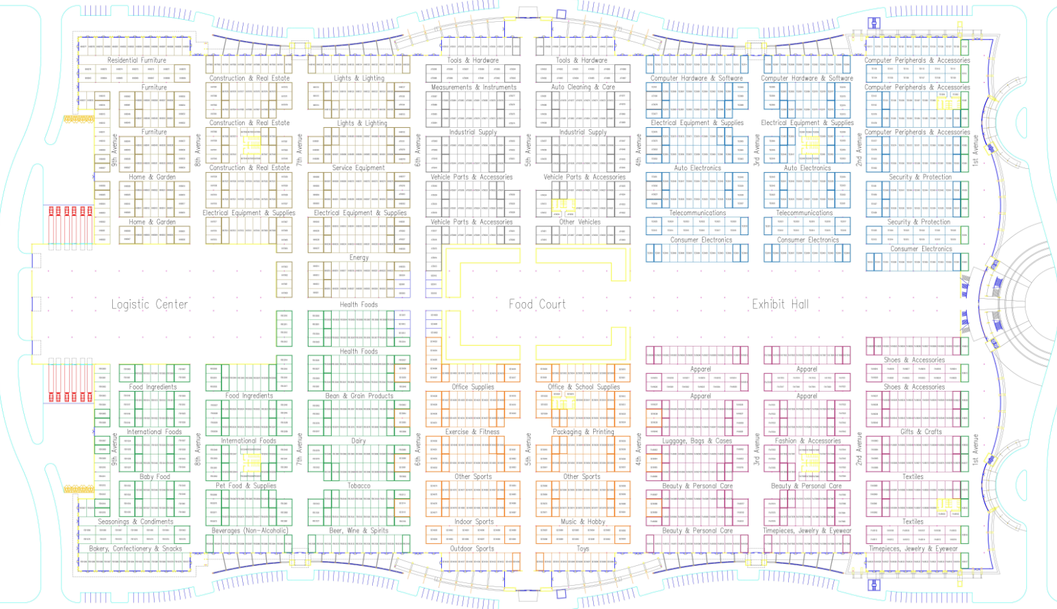
PhoenixMart: Floor Plan

Slide 23
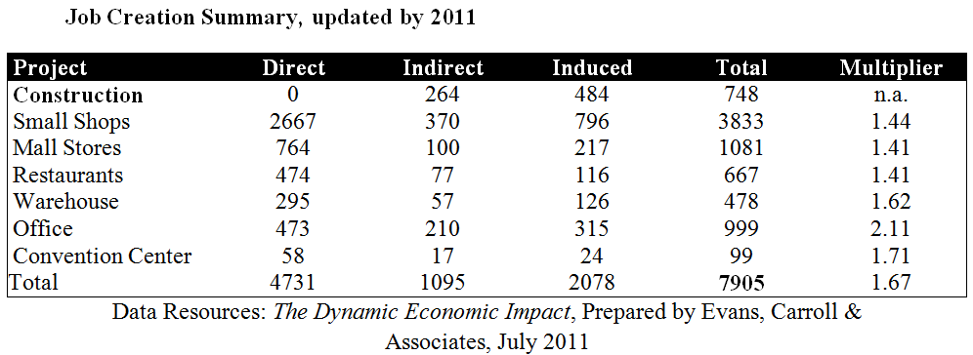
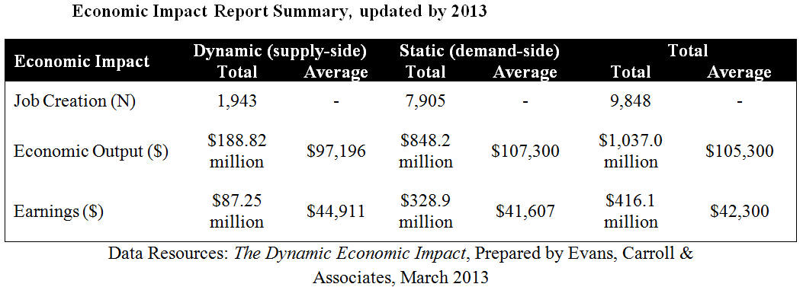
PhoenixMart: Economic Impact

