Slide 1
The Grind Continues
Pinal Partnership
December 14th, 2012
Presented By:
Elliott D. Pollack
CEO, Elliott D. Pollack & Company
Notes:
1
1
1

Slide 2
Economic Conditions

Slide 3
The economy we wanted…
Notes:
3

Slide 4
What we got…
Notes:
4

Slide 5
It is only because conditions have been so poor for so long that we feel this mediocre recovery is OK.

Slide 6
NATIONAL ECONOMY –
Continued subpar growth. But, recovery should continue. (unless the Federal Gov’t does something stupid…)

Slide 7
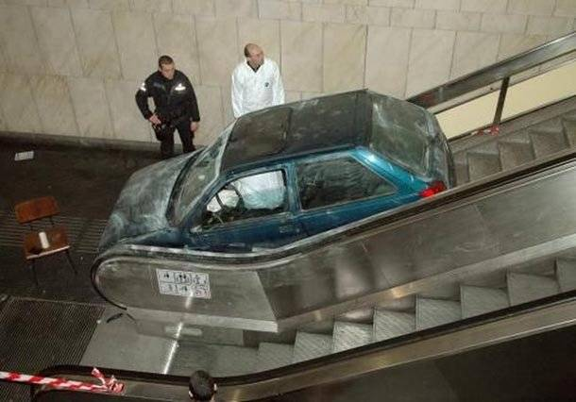
Speaking of stupid…

Slide 8
FISCAL CLIFF
2013

Slide 9
Speaking of stupid…

Slide 10
FISCAL CLIFF
January 2, 2013:
Bush-era tax cuts expire.
$3.3 trillion over 10 years
$330 billion in 2013
Fiscal tightening measures agreed to last year kick in…
$1.2 trillion in cuts over 9 years
$500 billion in defense
($55 billion in 2013)

Slide 11
FISCAL CLIFF
Causes great uncertainty.
Cost of non-resolution would be a recession in 2013 (CBO).
So, most likely some type of resolution will occur in early 2013.

Slide 12
ObamaCare
Summed up in one sentence by:
Barbara Bellar (Candidate for Illinois State Senate)

Slide 13
ObamaCare Summed up in One Sentence
“We are going to be gifted with a health care plan we are forced to purchase, and fined if we don’t…

Slide 14
ObamaCare Summed up in One Sentence
…which reportedly covers at least 10 million more people, without adding a single new doctor, but provides for 16,000 new IRS agents…

Slide 15
ObamaCare Summed up in One Sentence
…written by a committee whose chairman says he doesn’t understand it…

Slide 16
ObamaCare Summed up in One Sentence
…passed by a congress that didn’t read it, but exempted themselves from it…

Slide 17
ObamaCare Summed up in One Sentence
…signed by a president (who smokes)…

Slide 18
ObamaCare Summed up in One Sentence
…with funding administered by a treasury chief (who didn’t pay his taxes)…

Slide 19
ObamaCare Summed up in One Sentence
…for which we will be taxed for four years before any benefits take affect…

Slide 20
ObamaCare Summed up in One Sentence
…by the government which has already bankrupted social security and Medicare…

Slide 21
ObamaCare Summed up in One Sentence
…all to be overseen by a surgeon general (who is obese), and financed by a country that’s broke.”

Slide 22
ObamaCare Summed up in One Sentence
What could possibly go wrong?

Slide 23
ObamaCare
Seriously, the issues are:
Uncertainty over costs
Uncertainty over implementation

Slide 24
United States Real Gross Domestic Product* Annual Growth 1970 - 2013** Source: U.S. Bureau of Economic Analysis & Blue Chip Economic Indicators
* Based on chained 2005 dollars.
** 2012 - 2013 are forecasts from the Blue Chip Economic Indicators, November 2012
Recession Periods
Notes:
24
24
24

Slide 25
At least we’re growing!
And growth should continue,
BUT…

Slide 26
…growth will remain weak because of the following:
Consumer spending modest, but up (Additional jobs and hours worked).
Business spending up
Excess industrial capacity.
Continued housing recovery in 2013. Large percent gain. Small numerical gain.
Limited commercial construction.
Continued pressure on state and local government.
Limited policy options on part of Federal government.
Notes:
26
26

Slide 27
Consumers
Notes:
27
27
27

Slide 28
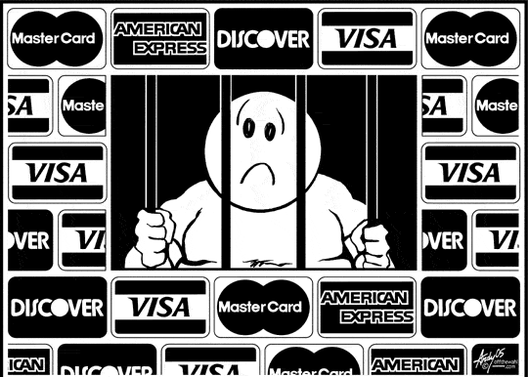
Consumer debt has declined by $1.7 trillion over the last 4 years.

Slide 29
Financial Obligation Ratio** 1980 – 2012* Source: Federal Reserve
Recession Periods
*Data through second quarter 2012
**Ratio of mortgage and consumer debt (including auto, rent and tax payments) to disposable income.
Notes:
29
29
29

Slide 30
Consumer Credit Outstanding Percent Change Year Ago 1970 – 2012* Source: The Federal Reserve Bank of St. Louis
Recession Periods
*Data through October 2012
Notes:
30
30
30

Slide 31
US New Job Data Change from Prior Month (S/A) June 2010 – November 2012 Source: Bureau Labor of Statistics
(000’s)
Notes:
31

Slide 32
Hours Worked Percent Change from Year Ago 1976 – 2012* Source: Bureau of Labor Statistics
Recession Periods
*Data through third quarter 2012
Notes:
32
32
32

Slide 33
Consumer Confidence 1978 – 2012* Source: The Dismal Scientist
Recession Periods
Normal
Normal
Normal
New Normal?
Approval of medical marijuana...
*Data through November 2012
Notes:
33
33
33
33

Slide 34
Number of Monthly Residential Refinances Greater Phoenix Source: CoreLogic

Slide 35
Refinancing will free up money…

Slide 36
WEALTH EFFECT
Housing prices are up.
Stock market is up from a year ago.

Slide 37
Consumer Summary:
Jobs are being created at a slow rate.
Those that have jobs are spending a little more but will remain cautious.
Unemployment to remain high, but should trend lower.
Wealth levels are improving.
Will the additional uncertainty translate into reduced consumer spending?
Notes:
37
37

Slide 38
Business
Notes:
38
38
38

Slide 39
Business debt has declined by $2.9 trillion over the last 4 years.

Slide 40
Corporate Profit (Billions of Dollars, SA) 1975-2012* Source: BEA
Recession Periods
*Data through third quarter 2012
Notes:
40
40

Slide 41
Business Spending on Equipment Percent Change from Prior Quarter 2005 – 2012* Source: Bureau of Economic Analysis
Recession Periods
*Data through third quarter 2012
Notes:
41
41
41

Slide 42
Business Spending on Plant Percent Change from Prior Quarter 2005 – 2012* Source: Bureau of Economic Analysis
Recession Periods
*Data through third quarter 2012
Notes:
42
42

Slide 43
Capacity Utilization Rate 1970 – 2012* Source: The Federal Reserve Bank of St. Louis
Recession Periods
This is when investment occurs.
*Data through October 2012
Notes:
43
43
43

Slide 44
Business Summary:
Businesses are in better shape.
Spending on equipment to continue to grow.
Spending on plant will lag until capacity utilization goes higher…getting close.
Employment to continue to grow.
Notes:
44
44

Slide 45
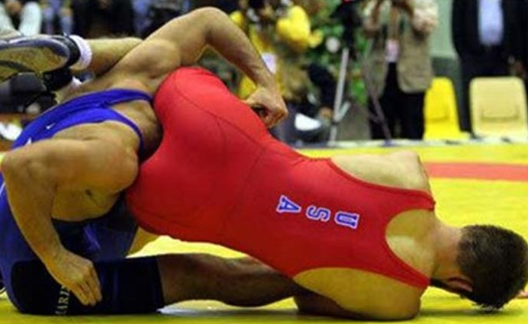
Government
Notes:
45
45
45
45

Slide 46
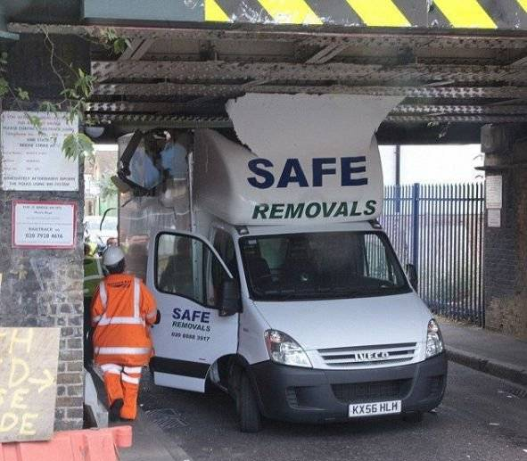
Speaking of stupid…

Slide 47
Gross Government debt has INCREASED by $5.8 trillion over the last 4 years.

Slide 48
Balanced Budget
We are borrowing $0.34 of every dollar we spend and can’t collect enough in taxes to make it up.

Slide 49
Balanced Budget
RECEIPTS | $ tril
Individual income taxes | 1.165
Corporate income taxes | 0.237
Social insurance & medicare taxes | 0.775
Unemployment insurance | 0.066
Other | 0.226
TOTAL | $2.469

Slide 50
Balanced Budget
EXPENDITURES | $ tril
Discretionary (security – military, defence, homeland security, FBI, CIA and non-security – departments of education, energy, etc.) | 1.319
Mandatory (Programs such as Medicare, Medicaid, SS, TARP) | 2.252
Interest on debt | 0.225
TOTAL | $3.796

Slide 51
Balanced Budget
EXPENDITURES $3.796 trillion
RECEIPTS $2.469 trillion
= DEFICIT $1.327 trillion
Discretionary Expenditures = $1.319 trillion

Slide 52
Balanced Budget
So, even if we completely shut down government, including the military, we still wouldn’t have a balanced budget.

Slide 53
Balanced Budget
The federal debt scheduled to be:
$16.2 trillion in 2013
$25.9 trillion in 2022
Source: U.S. Treasury; FY 2013 U.S. Budget

Slide 54
U.S. Gross National Debt ($tril) Source: U.S. Treasury; FY 2013 U.S. Budget
---- Obama Administration proposed budget, Aug. 2012

Slide 55
What is the tipping point?

Slide 56
It WILL happen but no one can tell when.

Slide 57
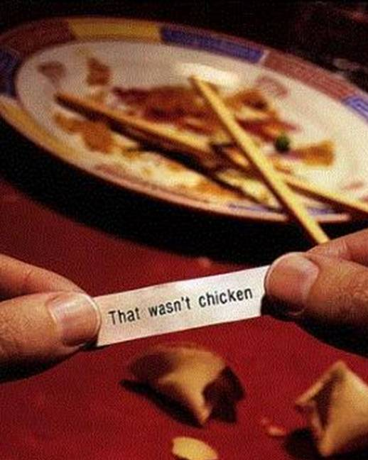
You won’t know what you’re getting until it’s TOO LATE.

Slide 58
What does the government need to do?
First, admit there is a problem
Second, deal with the problem.
It will be painful and there is no easy way out.
Notes:
58

Slide 59
What does the government need to do?
Need significant cuts in the rate of increase for long term fiscal health.
Modest tax increases designed not to hurt incentives.
But, significant cuts or tax increases will hurt the economy next year.
Therefore, they need to phase it in!!!
Notes:
59

Slide 60
Government Summary:
State & local under pressure.
But, more revenues available in FY2013.
Federal spending up but more slowly.
Need to avoid a self imposed “cliff.”
Notes:
60
60

Slide 61
Question:
Can Europe cause a recession in the U.S.?

Slide 62
Conclusion:
Europe unlikely to cause any significant problems for U.S.

Slide 63
NATIONAL SUMMARY
Consumers still restructuring
Confidence low, but spending will continue to grow
Business in good shape but not confident because of:
Low capacity utilization
Cost of Obama Care
Potential for Fiscal Cliff
Federal government, no leadership whatsoever.

Slide 64
ARIZONA Happy Birthday!!

Slide 65
Arizona & US Move Together (Non-farm Emp. Percent Change 1980 – October 2012)
Recession Periods
Notes:
65
U.S. data through November, AZ data through October

Slide 66
Job Growth 2006
Source: US BLS
Alaska
10
7
9
5
1
4
3
22
15
8
Hawaii
2
11
Jobs growing
6
Top 10
13
Jobs declining

Slide 67
Job Growth 2009
Alaska 2
Source: US BLS
34
20
1
46
44
3
7
24
5
10
50
9
36
30
6
45
Hawaii
49
25
Jobs growing
8
4
Top 10
Jobs declining
Notes:
67

Slide 68
Job Growth 2011
Source: US BLS
Alaska
17
12
50
1
22
10
38
7
25
4
34
29
2
6
30
9
5
Hawaii
23
44
Jobs growing
3
8
Top 10
Jobs declining
Notes:
68
68
68

Slide 69
Job Growth 2012
YTD October 2012 vs YTD October 2011
Source: US BLS
Alaska
43
11
29
1
33
12
30
35
50
4
7
9
10
16
5
6
2
Hawaii
47
Jobs growing
3
8
Top 10
Jobs declining
Notes:
69
69
69

Slide 70
There is little that isn’t transitory…
…It is mostly cyclical

Slide 71
How did AZ go from 2nd to 49th?
Financial meltdown.
Credit crunch/freeze.
Overextended consumer.
Excess single family inventory.
Housing prices decline.
Loss of wealth including home equity.
Can’t sell homes or retire.
Homebuilding and home prices crash.
Population inflows weaken in AZ.
Household size increases.
Household formations decline.
Excess commercial construction
“Growth” job losses.
All sector job loses.

Slide 72
How does AZ go from 49th to 2nd?
Overall US economic recovery improves.
Stock market improves.
Credit frees up.
Consumers more confident.
People start to move to AZ again, slowly.
Investors help absorb excess housing.
Excess housing absorbed
Housing prices rise.
Construction kicks in.
Construction job gains.
All sector job gains.
More people move to AZ.

Slide 73
But the local recovery will be slow because…
Slow national recovery
Consumers still restructuring
Low levels of confidence
Winding down of defense sector
Population flows slow:
40% of U.S. households are not mortgage creditworthy.
More than 39% in Arizona and 22% nationally have no equity in their homes.

Slide 74
Arizona Employment Growth Source: Arizona State University, U.S. Bureau of Labor Statistics
Year | Rank
1991 | 20
1992 | 21
1993 | 5
1994 | 2
1995 | 2
1996 | 2
1997 | 2
1998 | 1
1999 | 2
Year | Rank
2000 | 5
2001 | 10
2002 | 12
2003 | 4
2004 | 2
2005 | 2
2006 | 2
2007 | 16
2008 | 46
2009 | 49
2010 | 49
2011 | 23
2012* | 6
*YTD October 2012 vs YTD October 2011
Notes:
74
74
74
74

Slide 75
Arizona Employment* Annual Percent Change 1975–2013** Source: Department of Commerce, Research Administration
*Non-agricultural wage & salary employment. Changed from SIC to NAICS reporting in 1990.
** 2012 & 2013 forecast is from Elliott D. Pollack & Co.
Recession Periods

Slide 76
FISCAL CLIFF

Slide 77
Speaking of stupid…

Slide 78
What will be the impact of defense cutbacks in Arizona?

Slide 79
FISCAL CLIFF IN ARIZONA?
Projected Net Job Growth:
2012 = 48,000
2013 = 73,600
2014 = 88,500
Notes:
79
79
79

Slide 80
FISCAL CLIFF IN ARIZONA?
If the mandated spending cuts take place, total loss to Arizona is projected at:
45,000 to 50,000 jobs.
(This does not take into account any slowdown caused by tax increases.)
We will still grow, but very slowly.
Notes:
80
80
80

Slide 81
Greater Phoenix Employment* Annual Percent Change 1975–2013** Source: Department of Commerce, Research Administration
*Non-agricultural wage & salary employment. Changed from SIC to NAICS reporting in 1990.
** 2012 & 2013 forecast is from Elliott D. Pollack & Co.
Recession Periods

Slide 82
Greater Phoenix Employment* Source: Bureau of Labor Statistics
Sectors in Decline | Net Change
Other Services | -1,100
Information | -500
Sectors Improving | Net Change
Professional & Bus Services | 13,100
Education & Health Services | 6,700
Trade, Transp, Utilities | 7,900
Financial Activities | 4,400
Government | 4,200
Construction | 3,200
Leisure & Hospitality | 1,700
Manufacturing | 1,200
Mining | 100
*Oct. 2012/ Oct. 2011
Notes:
82
Not sure what sectors need to be highlighted for June/July
82

Slide 83
Greater Phoenix- Jobs Finally in the Black
Over last 12 months: 40,800
12 months before that: 34,200
12 months before that: 1,300
12 months before that: (149,700)
12 months before that: (83,300)
* As of October 2012
Notes:
83
83
83

Slide 84
Greater Phoenix Jobs
Source: BLS
Jobs lost Peak to Trough: 302,500
(Dec-07) (Jul-10)
Jobs gained Trough to Current: 133,500
(Jul-10) (Oct-12)
***We are 44% of the way back***
*Based on not seasonally adjusted monthly data
Notes:
84
84
84

Slide 85
Employment Levels: Greater Phoenix back to Peak in 2015? Source: ADOC
Recession Periods
Peak

Slide 86
Greater Phoenix Non-Farm Employment Gains
3 Years After Recession End
Source: BLS
Notes:
86

Slide 87
Phoenix-Mesa Employment Growth (Ranking among all metro areas greater than 1,000,000) Source: Arizona State University, U.S. Bureau of Labor Statistics
Year | Rank | # MSA’s
1991 | 4 | 19
1992 | 4 | 19
1993 | 2 | 19
1994 | 1 | 19
1995 | 1 | 20
1996 | 1 | 21
1997 | 1 | 22
1998 | 1 | 23
1999 | 3 | 24
Year | Rank | # MSA’s
2000 | 9 | 25
2001 | 7 | 26
2002 | 5 | 25
2003 | 3 | 25
2004 | 3 | 25
2005 | 1 | 26
2006 | 1 | 27
2007 | 9 | 28
2008 | 24 | 28
2009 | 24 | 25
2010 | 24 | 24
2011 | 12 | 24
2012* | 3 | 25
*Year-to-date, October 2012
Notes:
87
87
87
87

Slide 88
Maricopa County Population Source: U.S. Bureau of Census; Arizona Department of Economic Security; University of Arizona Forecasting Project
Year Population
1950 331,770
1960 663,510
1970 971,228
1980 1,509,175
1990 2,122,101
2000 3,072,149
2010 3,817,117
2020(forecast) 4,831,137
Notes:
88

Slide 89
Greater Phoenix Employment Source: U.S. Bureau of Census; Arizona Department of Administration; University of Arizona Forecasting Project
YEAR | EMPLOYMENT
1950 | 74,400
1960 | 181,700
1970 | 327,200
1980 | 636,200
1990 | 1,013,300
2000 | 1,578,400
2010 | 1,686,800
2020 | 2,312,700
Notes:
89

Slide 90
Greater Phoenix Population Annual Percent Change 1976–2013* Source: Arizona State University & Department of Commerce, Research Administration
Recession Periods
.
* 2012 & 2013 forecast is from Elliott D. Pollack & Co.

Slide 91
School Enrollment Growth 2001-2012 Source: Arizona Department of Education
N/A
*Collection methodology changed in 2009, rendering 2009/2008 comparisons null.

Slide 92
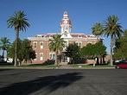
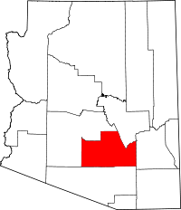
Pinal County

Slide 93
Pinal County Employment Annual Percent Change 1975–2012* Source: Workforce AZ
*Data through October 2012
Recession Periods
Notes:
93
Did not update

Slide 94
Pinal County Employment* Source: Workforce AZ
Sectors in Decline
Information | -5.9%
Financial Activities | -5.5%
Manufacturing | -0.8%
Sectors in Growing
Prof. & Business Services | 7.6%
Leisure & Hospitality | 6.3%
Education & Health Services | 4.3%
Government | 3.9%
Mining & Construction | 0.9%
Trade, Transp., & Utilities | 0.3%
*October 2012/October 2011
Notes:
94

Slide 95
Pinal County Retail Sales Percent Change Year Ago* 1999 – 2012** Source: Arizona Department of Revenue
Recession Periods
*Data through September 2012
**3-month moving average
Note: January 2010 and March 2010 retail sales are estimates.
Notes:
95
Up-to-date

Slide 96
Pinal County Single Family Permits 1996–2012* Source: Census Bureau
*YTD September 2012
Recession Periods
Notes:
96
Did not update

Slide 97
The real estate market we wanted…
Notes:
97

Slide 98
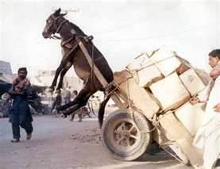
The real estate market we got…
Notes:
98

Slide 99
It’s hard not to be optimistic about HOUSING

Slide 100
US Total Vacant Housing Units 1965-2012* Source: US Census Bureau
(000)
Recession Periods
Longer term trend
*Data through 2012 Q3

Slide 101
Housing
Good
Not a light switch…
Bad
A dimmer switch…
Mediocre
Not great
OK
Bad
Good
Terrible
Great

Slide 102
Think of what the housing market is going through as the same as any manufacturer that finds themselves with excess inventory…
Prices are cut until the excess is sold.
Then prices rise.
Notes:
102
102

Slide 103
Price gains are largely in distressed properties.

Slide 104
Total Single Family Units Occupied by Renters 2000-2011 Greater Phoenix Source: American Community Survey

Slide 105
U.S. Homeownership Rate 1994-2012* Source: Census Bureau
%
Recession Periods
*Data through 2012 Q2
Notes:
105
105

Slide 106
Percent of Homeowners by Market Status Source: CoreLogic
Homeowners that could be in resale market: 57.6%
(Free & clear or LTV less than 80%)
Homeowners not in resale market: 42.4%
(Little or no equity)

Slide 107
Also, 40% of Households are not credit worthy.
Source: CoreLogic

Slide 108
Until this gets resolved locally and nationally, the rate of population growth will be anemic.

Slide 109
This will limit the rate of growth in jobs.

Slide 110
As housing prices go up, more and more people will be able to sell their homes because they aren’t underwater.

Slide 111
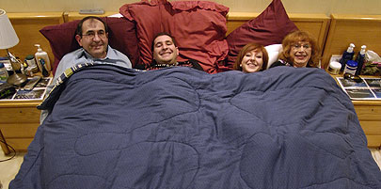
Household Formations
Lower during recessions (doubling up, living at home with mom & dad, etc)
Notes:
111
111

Slide 112
Percent of 25-34 Year Olds Living With Parents vs. Homeownership Rate, Under 35 Years Old U.S.: 1983 – 2011 Source: US Census Bureau
Notes:
112

Slide 113
In a weak economy, population growth fails to translate into household growth, but when the economy begins to strengthen, there is pent-up demand for housing.
Source: Linneman Letter
Notes:
113

Slide 114
As new housing and housing prices recover, the entire economy is helped.
Notes:
114
114

Slide 115
There are still issues…
Population flows
Interest rates
Notes:
115
115

Slide 116
So, we are on the right track.
Notes:
116
116

Slide 117
But, we are recovering, we are not recovered.
Notes:
117
117

Slide 118
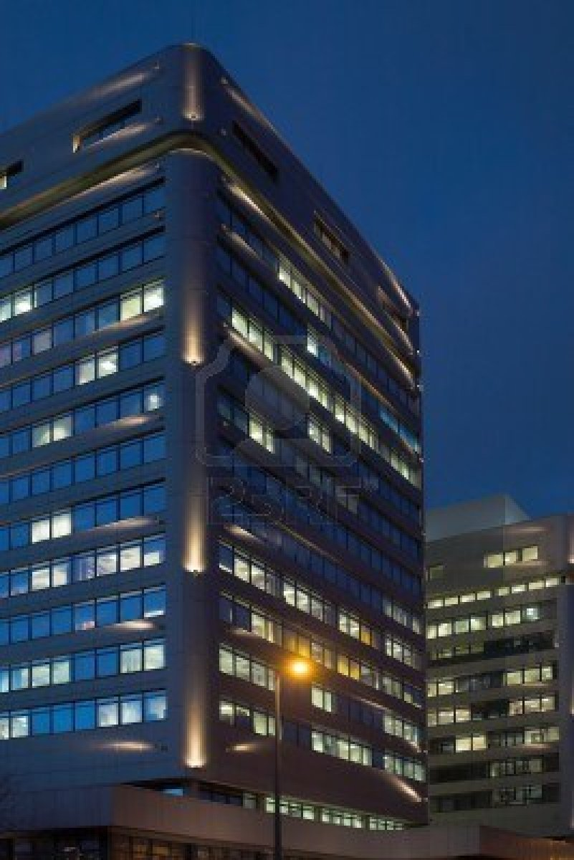
OFFICE
More lights on?
Notes:
118
118

Slide 119
As of third quarter 2012, there are 300,975 square feet of office space under construction.
Source: CBRE
Notes:
119
119

Slide 120
Under any reasonable employment growth scenario, we believe it will be 2016 before any significant office construction occurs (although some sub-markets will be sooner).
Notes:
120
120

Slide 121
INDUSTRIAL
Slowly filling up?
Notes:
121
121

Slide 122
As of third quarter 2012, there are 5.4 million square feet of industrial space under construction.
Source: CBRE
Notes:
122
122

Slide 123
RETAIL
Notes:
123
123

Slide 124
As of third quarter 2012, there are 0.9 million square feet of retail space under construction.
Source: CBRE
Notes:
124
124

Slide 125
CONCLUSIONS: How will it all turn out?

Slide 126
The Result….

Slide 127
The economy is improving in both absolute and relative terms.

Slide 128
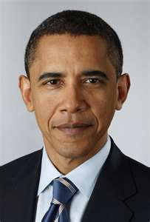
Is the Glass Still Half Full?
Notes:
128

Slide 129
Growth is slow by historic standards because the U.S. economy is slow and incentives are perverse.

Slide 130
The economy should gain some momentum (unless the Federal government does something stupid)

Slide 131
Speaking of Stupid…

Slide 132
There is a BOOM for Arizona out there somewhere.
Notes:
132
132

Slide 133
But not in
2013.
Notes:
133
133

Slide 134
ARIZONA– Slow but mildly accelerating recovery.
2013 will be better than 2012
2014 will be better than 2013
2015 should be a good year.

Slide 135
ELLIOTT D. POLLACK
& Company
Economic and Fiscal Impact Analysis/Modeling
Real Estate Market and Feasibility Studies
Litigation Support
Revenue Forecasting
Keynote Speaking
Public Finance and Policy Development
Land Use Economics
Economic Development
7505 East Sixth Avenue, Suite 100 Scottsdale, Arizona 85251
480-423-9200 P / 480-423-5942 F / www.arizonaeconomy.com / info@edpco.com
Notes:
135
135
135

